Slide 1
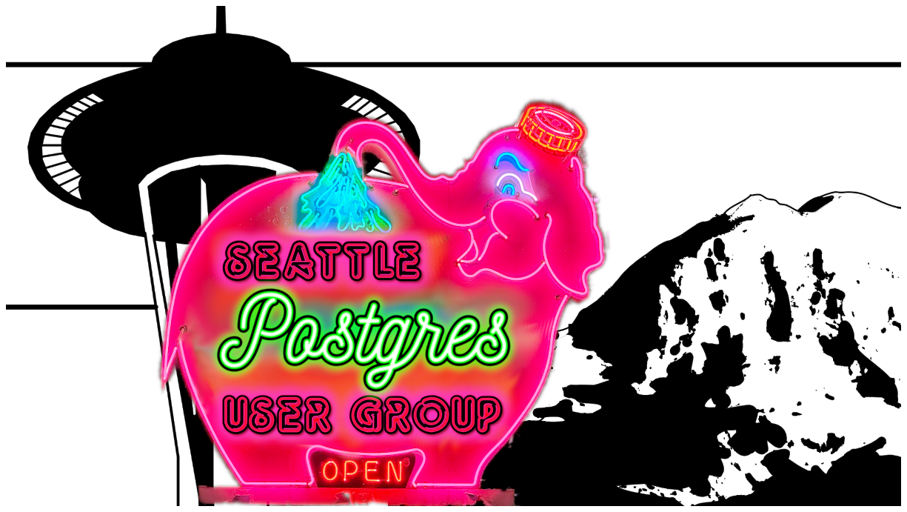

Slide 2

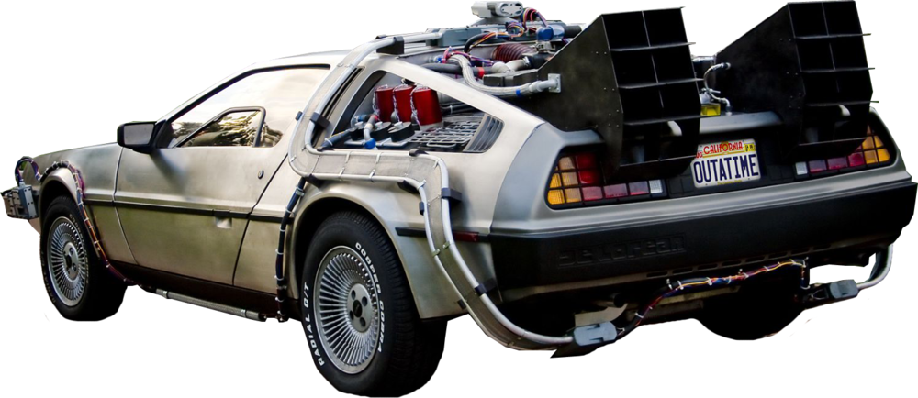
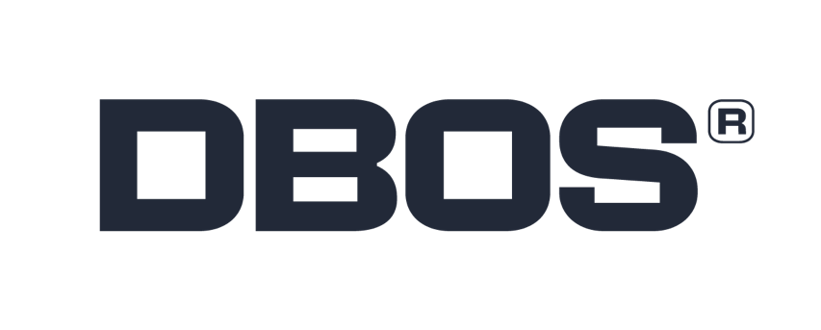
Time Travel Queries with Postgres
Harry Pierson, Staff Engineer
harry.pierson@dbos.dev
@DevHawk
Notes:
One sec, this was supposed to have been taken care of before we started
<hand to ear>
Yeah, it’s me. I told you I didn’t want to use the Delorean.
Yes, I know it’s iconic. It’s also overused. This is the 2nd time travel debugger I’ve built in my career. Guess what pop culture iconography we used in our articles and presentations last time?
Of course it was the Delorean! Can we please do something else?

Slide 3

Time Travel Queries with Postgres
Harry Pierson, Staff Engineer
harry.pierson@dbos.dev
@DevHawk
Notes:
OK, HG Wells Time Machine. Not bad. The OG. Not exactly contemporary though. What else do you have?

Slide 4

Time Travel Queries with Postgres
Harry Pierson, Staff Engineer
harry.pierson@dbos.dev
@DevHawk
Notes:
No, Pretty sure Terminator is not the vibe I should be going for here.

Slide 5
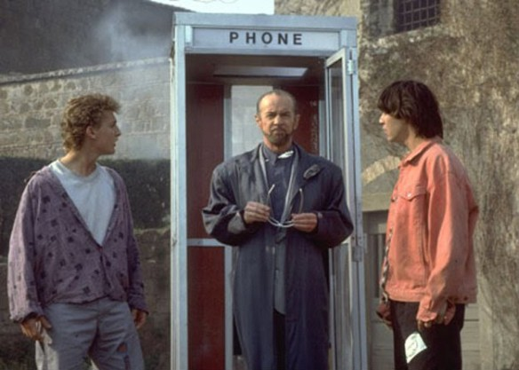
Time Travel Queries with Postgres
Harry Pierson, Staff Engineer
harry.pierson@dbos.dev
@DevHawk
Notes:
Bill and ted, perfect. Let’s use that.
I even have a story about bill and ted… <tell story>
Of course, we’re not here to talk about time travel in pop culture.
We’re here to talk about time travel in post-gres

Slide 6
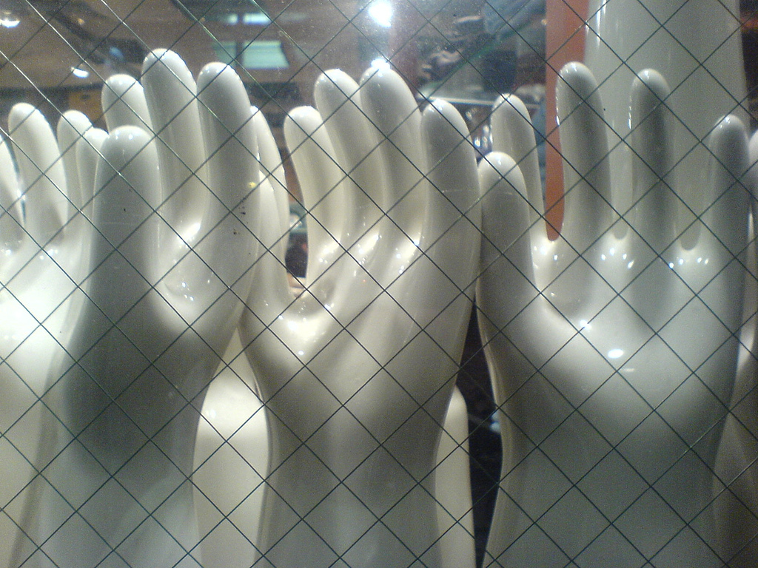
Notes:
Show of hands:
Who has used the native, built in support for Time Travel Queries in Postgres?
Who was aware that Postgres had native, built in support for Time Travel Queries?

Slide 7
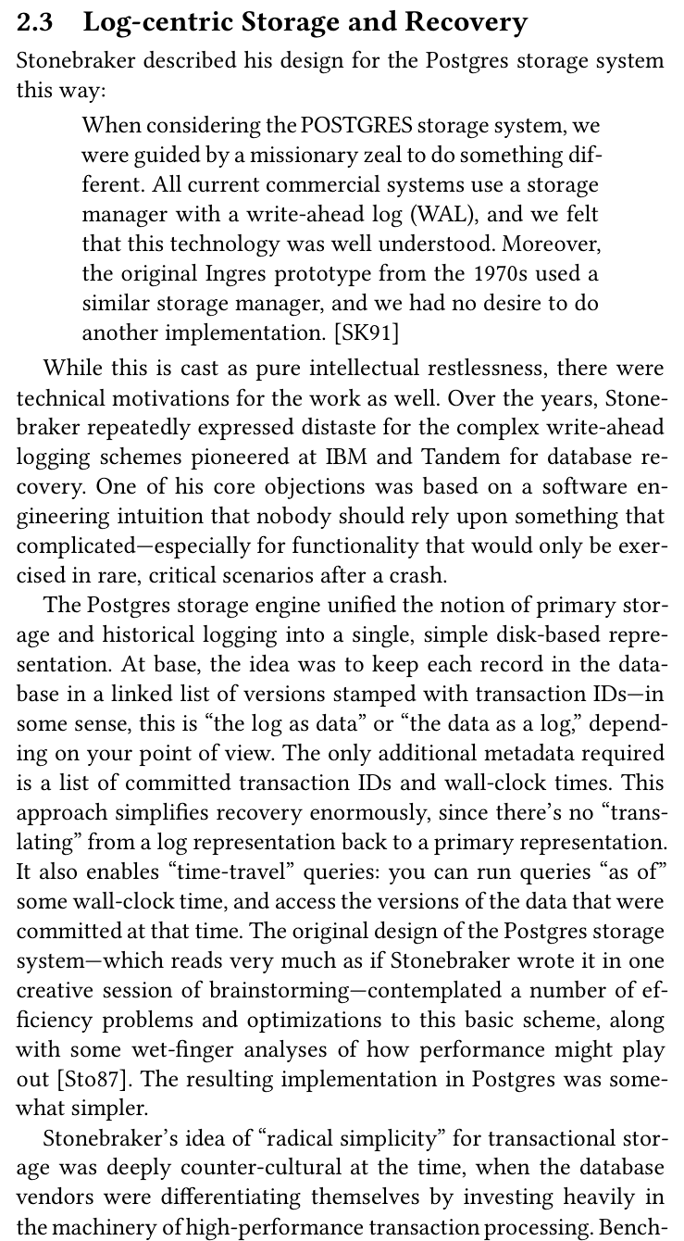
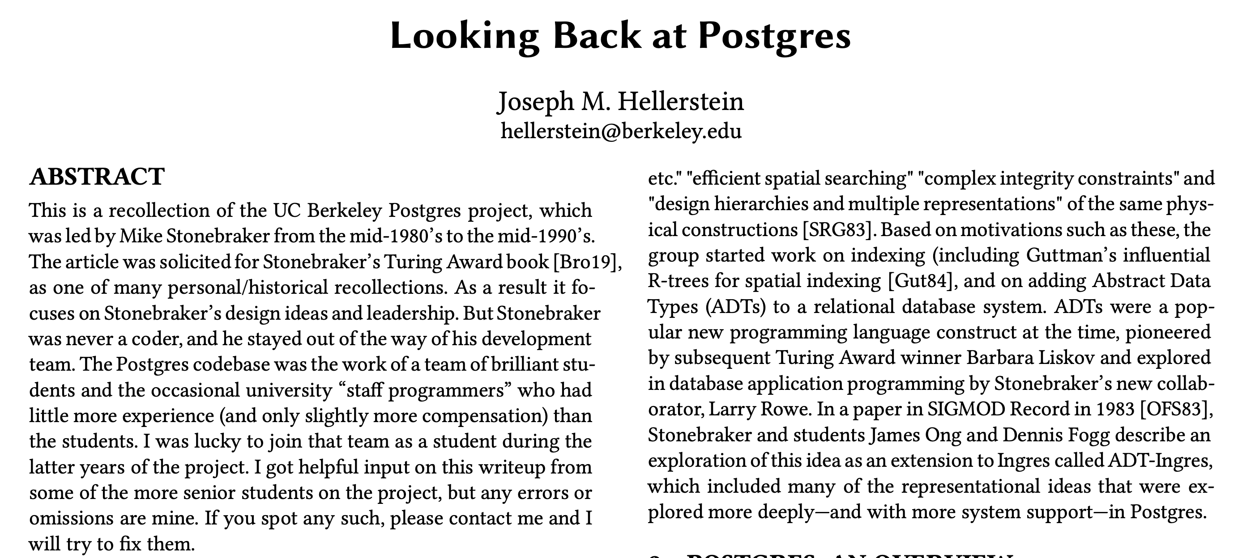
Once Upon A Time…
https://arxiv.org/pdf/1901.01973v1
Notes:
https://arxiv.org/pdf/1901.01973v1

Slide 8
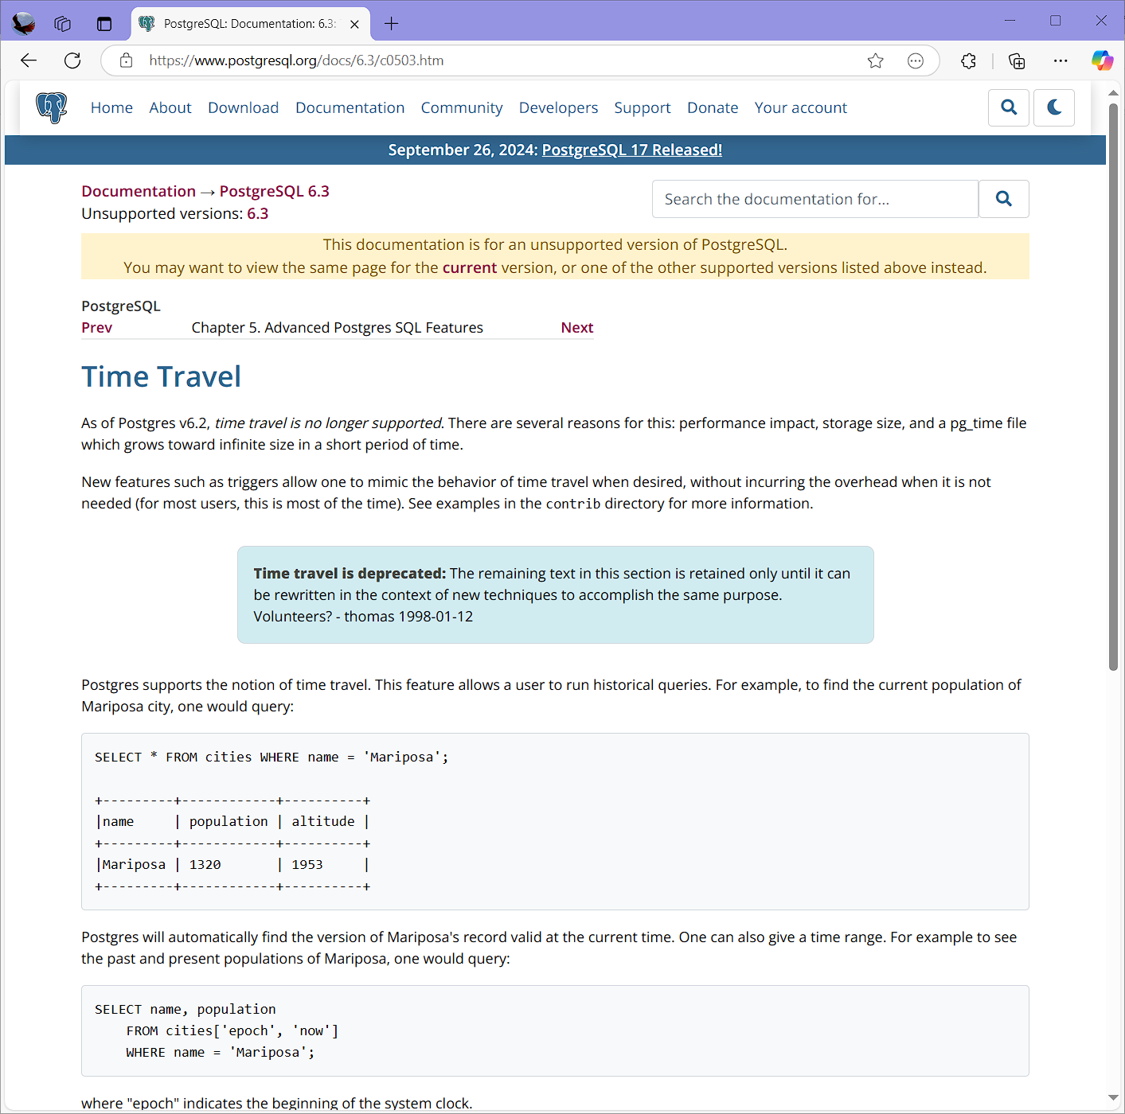
…Didn’t Live Happily Ever After
Notes:
https://www.postgresql.org/docs/6.3/c0503.htm

Slide 9
Time Travel Queries Are a Useful Feature!
Periodic reporting
Auditing
Debugging
Regulatory Compliance
(GDPR, CCPA, …)
Recovery

Slide 10
New Implementations Emerge…
Notes:
You may ask, I can already do time travel with existing implementations!

Slide 11
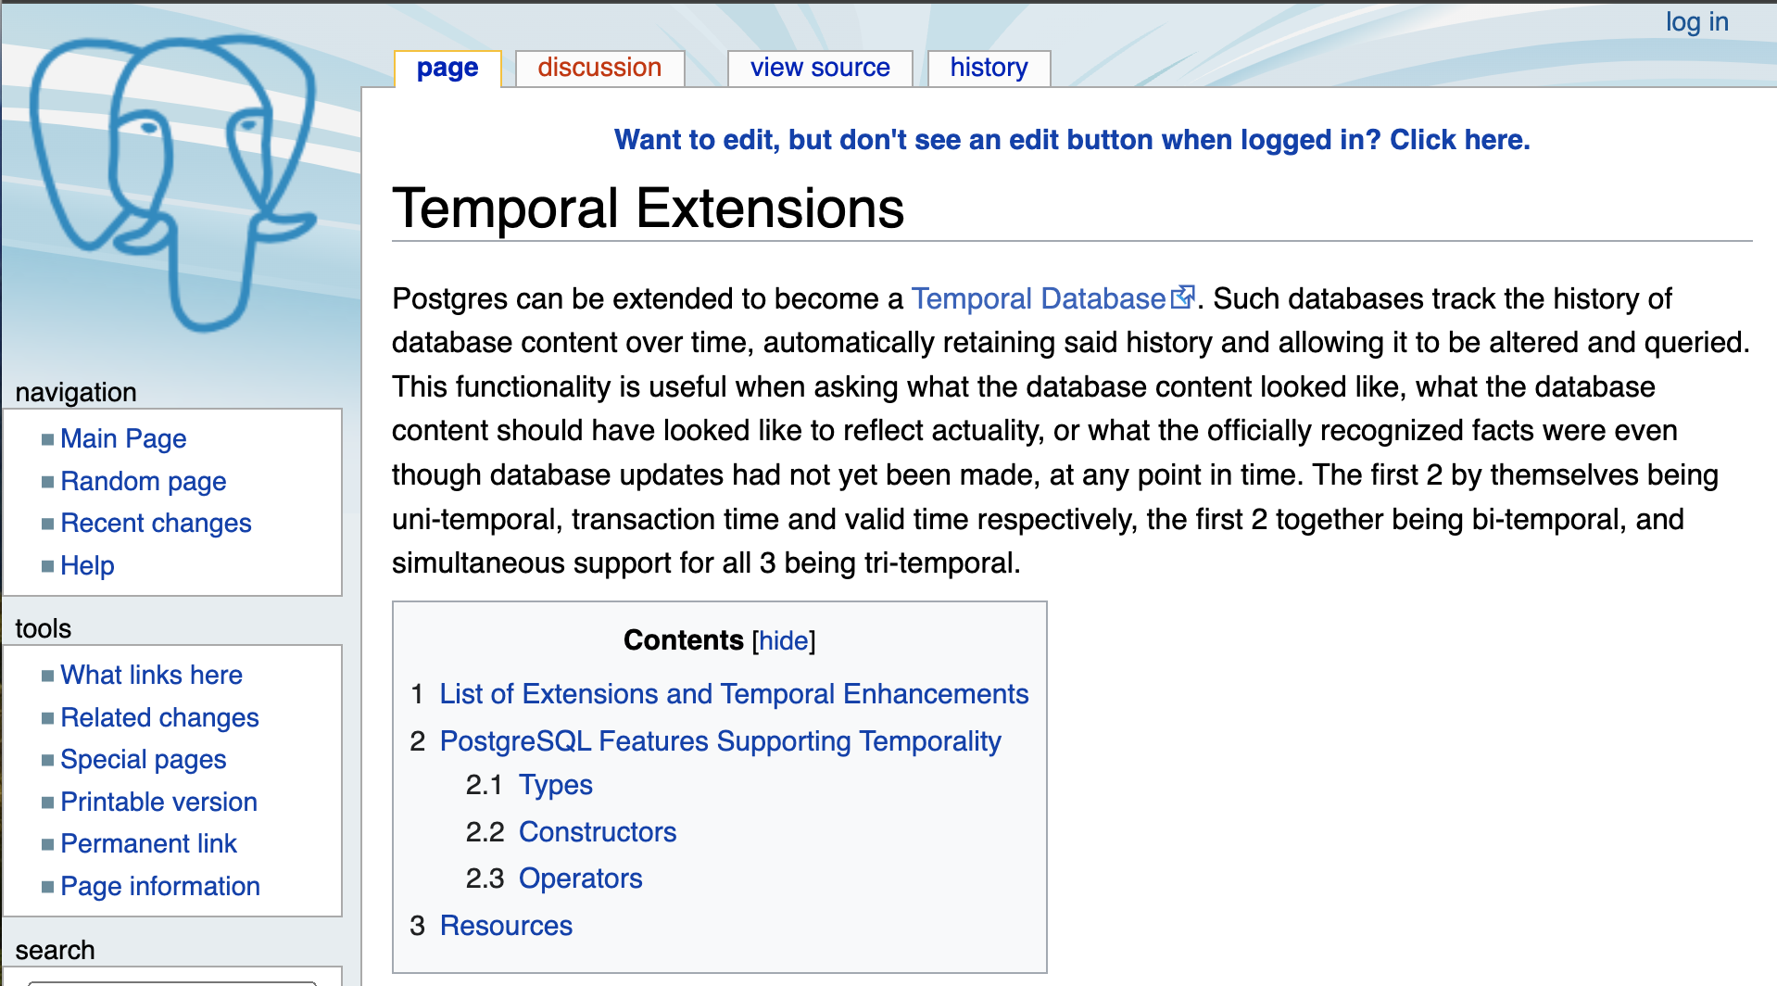
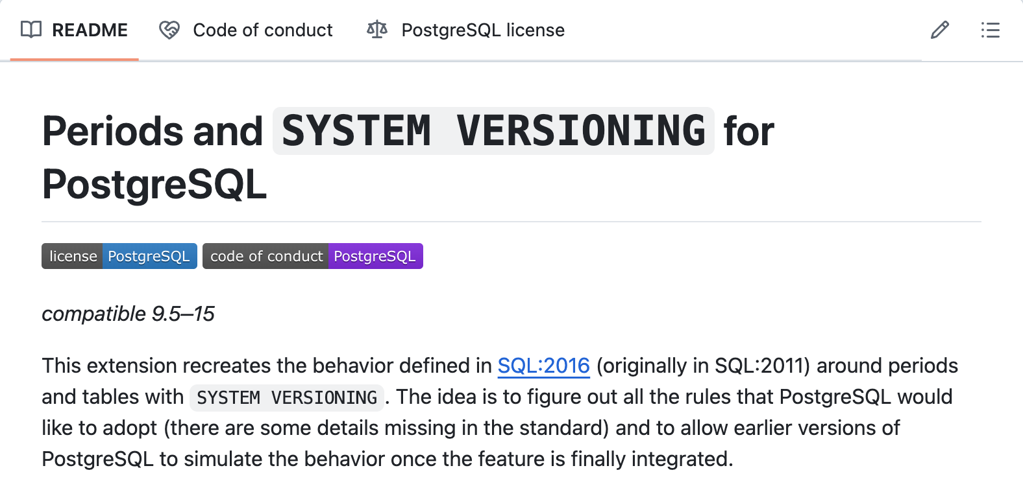
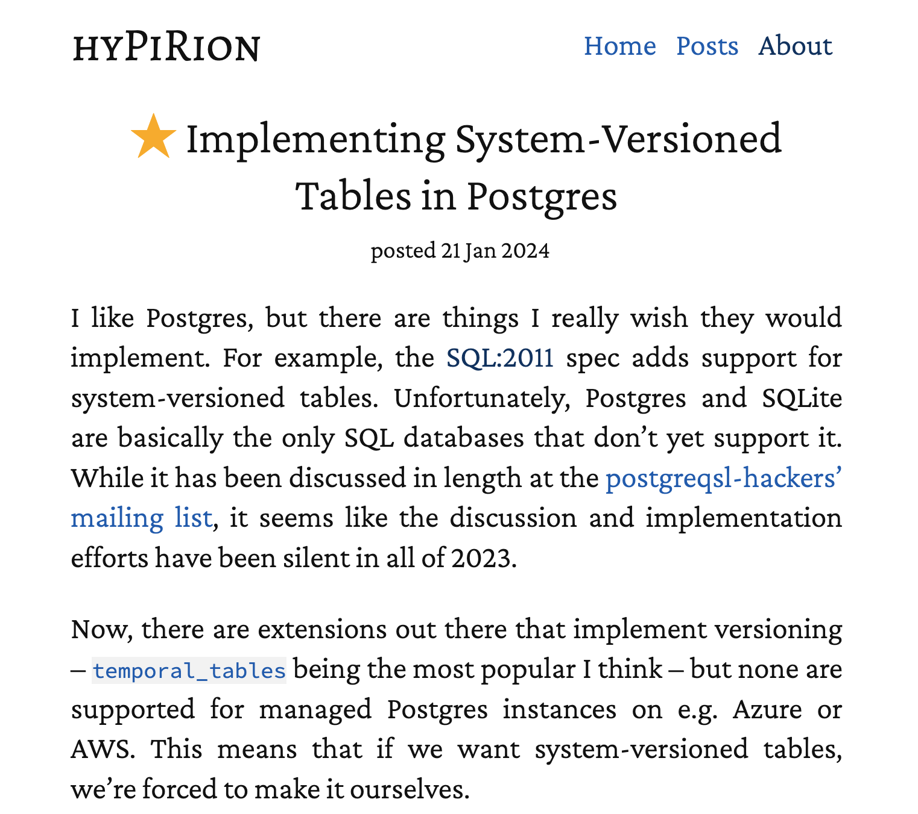
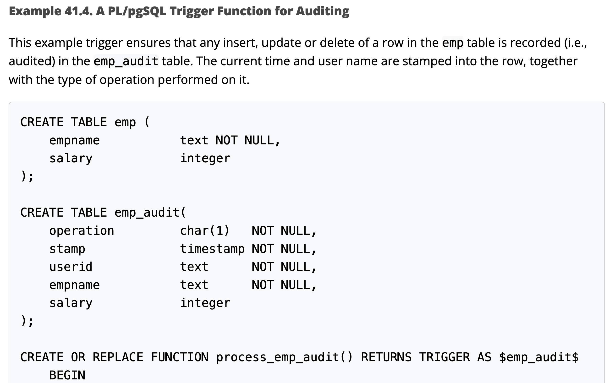
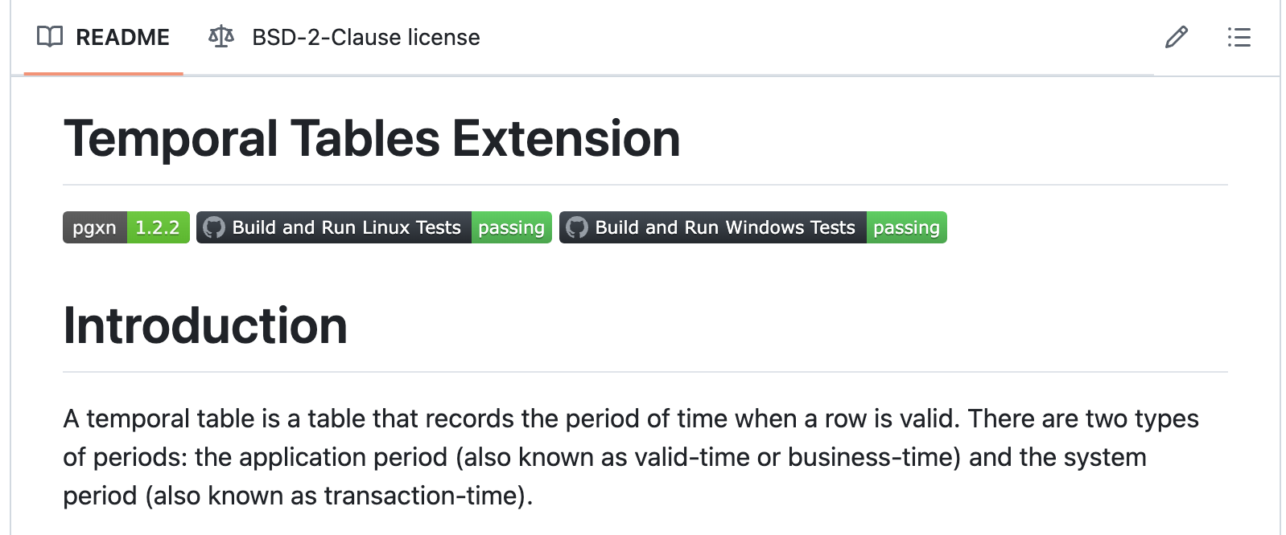
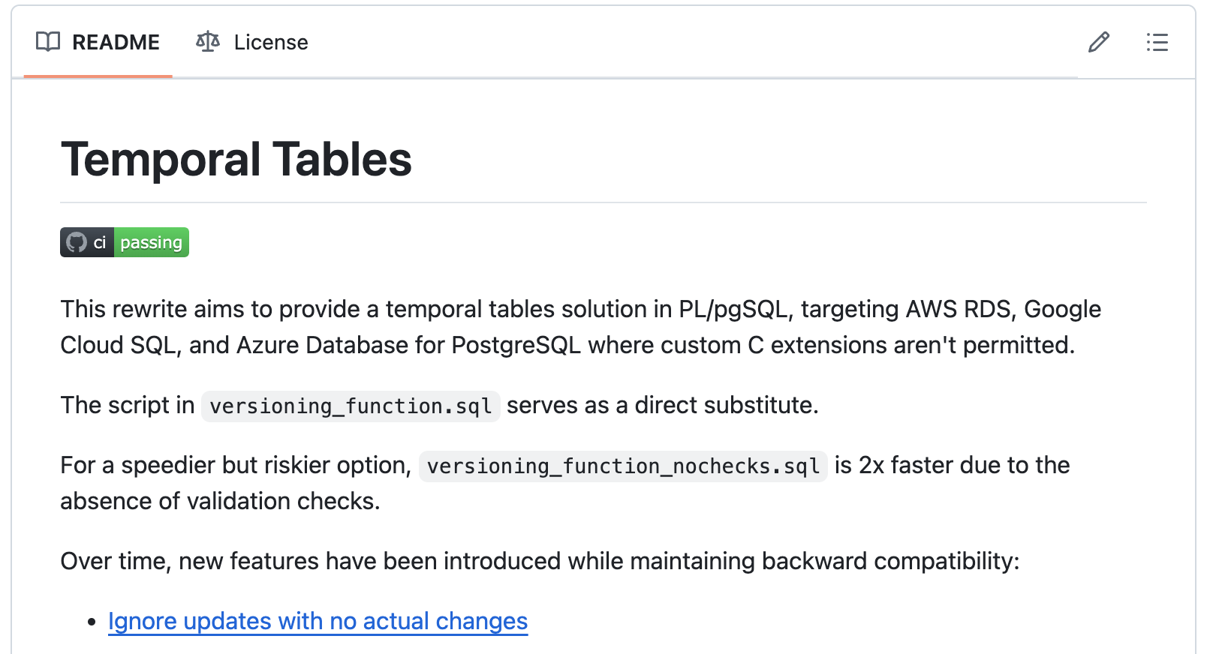
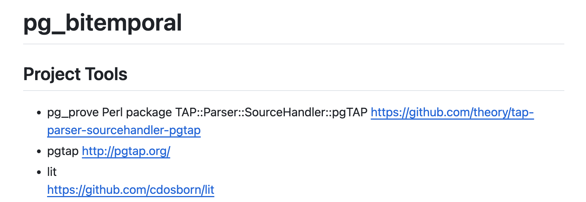
New Implementations Emerge…
Notes:
You may ask, I can already do time travel with existing implementations!

Slide 12
…With a Generally Shared Design
Every app table gets a history or audit table counterpart
Trigger or Extension updates history table when app table is modified
Significant issues with this approach
Inserts
Deletes
Updates
App Tables
App History Tables
App Tables
App History Tables
App Tables
App History Tables
App DB
Notes:
The main thing is that they store all past versions in the same database. It leads to two main issues.
First, Performance impact, write amplification, every change will cause multiple writes to the database.
Every old version is stored in your DB. Imagine a table that is never vacuumed. Huge database, large tables, one large temporal query that consumes huge amount of CPU and memory can impact other concurrent processes on your app DB.
Second, Hard to maintain table schemas, must keep them in sync, otherwise, your trigger function would fail and cause errors to your normal transactions. So it may interrupt your business and even lead to data corruptions.

Slide 13
Novel Approach from DBOS
History data stored in a separate database
Changes exported via Logical Replication
Source changes transformed to Multi-Version Format
Time Travel Proxy provides PG Wire Protocol compatibility
Time Travel Proxy
App Tables
Logical Replication
Inserts
Deletes
Updates
Multi-Version
Transform
Add TX Info To History Records
App History Tables
App Tables
App History Tables
App Tables
App History Tables
App DB
Provenance DB
Notes:
Using a separate db solves performance issues
Using logical replication eliminates schema migration issues
Works with off-the-shelf/managed Postgres servers
Bonus: Enables transaction debugging

Slide 14
Multi-Version Format
Notes:
First, let’s look at the multi-versioned exporter.
Export changes to a separate provenance database

Slide 15
Multi-Versioned History Tables
Use transaction ID as the logical timestamp
Extend each table with two columns
  begin_xid: added the record
  end_xid: deleted the record
  Updated modeled as Insert + Delete
Each version is visible between begin_xid and end_xid
Inspired by the Postgres
implementation of MVCC
Notes:
Use Txn ID, as it is available in WAL. This will also unlock transaction debugging.
Data model inspired by multi-version concurrency control (MVCC)
At each point, only one version is visible

Slide 16

Multi-Version Format Example
App DB Products Table (aka current data)
product | inventory
Premium Quality Widget | 98
WAL Record
Transformation
Provenance DB Products Table (aka historical data)
product | inventory | begin_xid | end_xid
Premium Quality Widget | 100 | 24818 | 24824
Premium Quality Widget | 99 | 24824 | 24826
Premium Quality Widget | 98 | 24826 | ∞

Slide 17
WAL Export and Transformation
Notes:
First, let’s look at the multi-versioned exporter.
Export changes to a separate provenance database

Slide 18
Write-Ahead Log (WAL)
WAL records describe data changes
  wal2json extension converts WAL records to a JSON format for easy parsing
{
"xid": "24818",
"kind": "insert",
"schema": "public",
"table": "products",
"columnnames": ["product", "inventory"],
"columntypes": ["text", "integer"],
"columnvalues": ["Premium Quality Widget", 100]
}
Notes:
https://github.com/eulerto/wal2json
We use the logically decoded WAL.
It tells you which kind of operation, which table, and the actual column names and values.

Slide 19
WAL Transformation
ETL-like pipeline
Update provenance tables with WAL data + TX ID information
  Provenance records are append-only
  Only transaction metadata can be modified
Notes:
Normally, logical replication ships this data to a backup replica server.
We implement a WAL transformer to populate the versioned table.
Looks like logical replication but instead of replicating the data, we enhance WAL with version info and update provenance tables.

Slide 20
WAL Transformation: Insert
For an insert, append the new record to the table
  begin_xid set to the transaction ID
  end_xid to infinity (latest version)
Example: add a new product
product | inventory | begin_xid | end_xid
Premium Quality Widget | 100 | 24818 | ∞

Slide 21
WAL Transformation: Delete
For a delete, find the current record (end_xid=∞)
  Update end_xid to the transaction ID
Example: delete a product
product | inventory | begin_xid | end_xid
Premium Quality Widget | 100 | 24818 | ∞
product | inventory | begin_xid | end_xid
Premium Quality Widget | 100 | 24818 | 24824

Slide 22
WAL Transformation: Update
For an update, first perform a delete and then insert a new version
Example: update a product’s inventory
product | inventory | begin_xid | end_xid
Premium Quality Widget | 100 | 24818 | ∞
product | inventory | begin_xid | end_xid
Premium Quality Widget | 100 | 24818 | 24824
Premium Quality Widget | 99 | 24824 | ∞

Slide 23
Garbage Collection
Bound the size of the provenance DB
Configurable Retention policy
Periodically remove old versions based on end_xid
Garbage Collect
24818 | … | 24824 | … | 24826
product | inventory | begin_xid | end_xid
Premium Quality Widget | 100 | 24818 | 24824
Premium Quality Widget | 99 | 24824 | 24826
Premium Quality Widget | 98 | 24826 | ∞
Notes:
Bound the size
retention policy

Slide 24
Time Travel Proxy
Notes:
How do we query the database as of a certain point in time?
Proxy Transform any PostgreSQL queries to “time-traveled” queries

Slide 25
Time Travel Proxy
Provides a “natural and familiar” experience for accessing
Provenance Database
Implements the PG Wire Protocol
Tracks “current time” for client connections
Implements custom SQL commands for changing “current time”
Transforms normal PostgreSQL queries to time traveled queries
Reads the visible version of the record at the point in time
  A version is visible at a given timestamp T if begin_xid is a transaction committed before T *AND* the end_xid is not committed before T
Notes:
Highly concurrent application
Some transactions are in progress
But you only see the committed versions at that point in time.

Slide 26
Visibility Rule
SELECT product, inventory FROM products;
24818 | … | 24824 | … | 24826
product | inventory | begin_xid | end_xid
Premium Quality Widget | 100 | 24818 | 24824
Premium Quality Widget | 99 | 24824 | 24826
Premium Quality Widget | 98 | 24826 | ∞
Notes:
As of the timestamp pointed by the blue arrow.

Slide 27
Visibility Rule
DBOS TIMESTAMP <24825>;
SELECT product, inventory FROM products;
24818 | … | 24824 | … | 24826
product | inventory | begin_xid | end_xid
Premium Quality Widget | 100 | 24818 | 24824
Premium Quality Widget | 99 | 24824 | 24826
Premium Quality Widget | 98 | 24826 | ∞
Notes:
As of the timestamp pointed by the blue arrow.

Slide 28
Visibility Rule
DBOS TIMESTAMP <24820>;
SELECT product, inventory FROM products;
24818 | … | 24824 | … | 24826
product | inventory | begin_xid | end_xid
Premium Quality Widget | 100 | 24818 | 24824
Premium Quality Widget | 99 | 24824 | 24826
Premium Quality Widget | 98 | 24826 | ∞
Notes:
As of the timestamp pointed by the blue arrow.

Slide 29
Visibility Rule
DBOS TIMESTAMP <24810>;
SELECT product, inventory FROM products;
24818 | … | 24824 | … | 24826
product | inventory | begin_xid | end_xid
Premium Quality Widget | 100 | 24818 | 24824
Premium Quality Widget | 99 | 24824 | 24826
Premium Quality Widget | 98 | 24826 | ∞
Notes:
As of the timestamp pointed by the blue arrow.

Slide 30
Which Transactions Have Committed?
Use the PostgreSQL’s snapshot info: pg_current_snapshot()
  xmin: transaction IDs < xmin are committed
  xmax: transation IDs >= xmax are not finished
  xip_list: between xmin and xmax but not committed
Notes:
Efficient representation. Maintain a huge list for every timestamp?

Slide 31
Query Transformation
Append two predicates to a query:
First, select versions added by committed transactions
Second, select versions not deleted by committed transactions
(begin_xid < xmax AND NOT begin_xid = ANY(xip_list))
AND (end_xid >= xmax OR end_xid = ANY(xip_list))

Slide 32
Example
SELECT product, inventory FROM products;
24818 | … | 24824 | … | 24826
SELECT product, inventory FROM products
WHERE (begin_xid < 24825) AND (end_xid >= 24825)

Slide 33
Time Travel Debugging

Slide 34
Replay Statements As Of a Past Transaction
BEGIN UPDATE products SET inventory = 50 WHERE product LIKE ‘Premium%’ RETURNING product, inventory; UPDATE products SET inventory = 100 WHERE product = ‘Premium Widget’ RETURNING product, inventory; COMMIT
Notes:
It will show up product premium widget updated twice in WAL records within the same transaction.

Slide 35
Challenges
Require read-your-own-writes within a transaction
WAL doesn’t track SQL statements
  Each transaction may have multiple statements
  Each statement may change multiple records
  Each record may be changed multiple times

Slide 36
Time Travel Debugging
Proxy transforms insert/delete/update to select queries
Keep track of which statement within the transaction made what changes
  begin_seq: The statement ID that added the record
  end_seq: The statement ID that deleted the record
Use PG triggers to record how many records are changed per statement
  Emit WAL messages

Slide 37
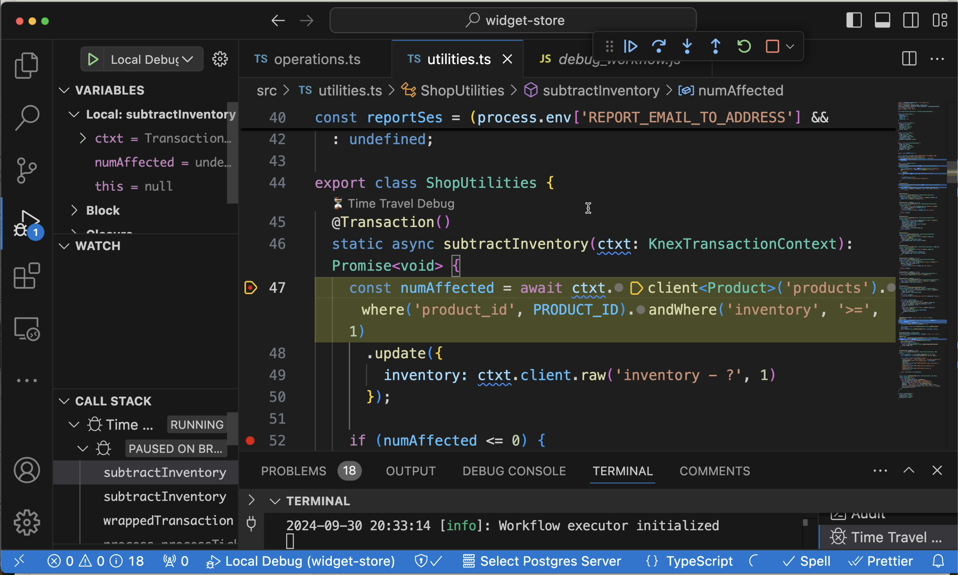
Time Travel Query Demo

Slide 38
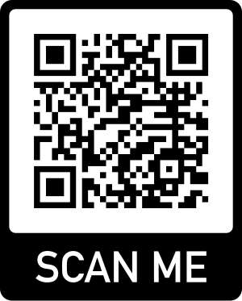
Try DBOS Time Travel
Tutorial
https://docs.dbos.dev/cloud-tutorials/interactive-timetravel
Case Study
https://www.dbos.dev/blog/database-time-travel

Slide 39
Summary
History data stored in a separate provenance database
Logical replication transformation to Multi-Version Format
Time Travel Proxy provides a “natural and familiar”
time travel query experience
Intra-Transaction statement tracking enables
Time Travel Debugging
Harry.Pierson@dbos.dev
@DevHawk
Notes:
Using a separate db solves performance issues
Using logical replication eliminates schema migration issues
Works with off-the-shelf/managed Postgres servers
Bonus: Enables transaction debugging

